Slide 1




AGRiSPHERE
Your SMART Farming Assistant

Slide 2
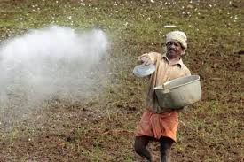
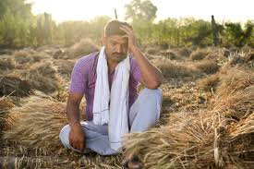
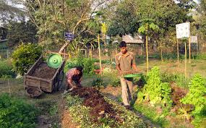
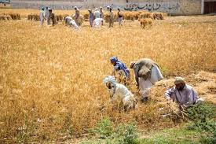
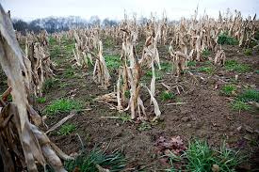

THE PROBLEM
Traditional agricultural practices and heuristic decision-making diminishes farmers' profitability.

Slide 3

CUSTOMER DISCOVERY
Statistics:
Insights:
Total farmers :25
Small(<5 acres):13
Medium: 5
Large(>25): 7
Experts: 2 (CTARA & Unnati Maharashtra Abhiyan project)
States: Maharashtra, Kerala, Rajasthan, Tamil Nadu, and Uttar Pradesh
High demand for training in modern practices
Financial constraints and tech skepticism
Varied needs across farm sizes
Collaborative potential in family-run farms
High equipment costs
Limited mobile tech comfort
Access issues with recommended products
Gaps in understanding of advanced techniques
Mixed views on tech investments
Questions:
Yield satisfaction
Crop/seed selection process
Soil health challenges
Fertilizer/pesticide decisions
Crop threat concerns
Harvest planning
Yield/profit obstacles
Tech comfort

Slide 4
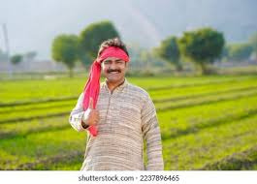
TARGET CUSTOMER
Ramesh
Medium-sized farmland owner
Goals:
1
Boost crop yields and profits.
Transition to modern farming practices.
Use data-driven insights for smarter decisions.
Demographics:
Land size: 5-35 acres
Income level: 30-75 lakhs/annum
Tech-comfortable
Rural & semi-urban areas
More receptive to new approaches
Challenges:
Reliance on outdated methods.
Limited awareness of modern solutions.
Financial constraints on investment.
Smooth transition from tradition to innovation

Slide 5
MARKET SIZE
TAM
(12 Cr)
All farmers across India
SAM
(1.4 Cr)
Medium sized farmland owners (5-35 acres)
Target Market
Medium sized farm land owners in Maharashtra, technologically affable, able to invest
(10 Lakhs)
Initial customers - Farmland Owners in Pune (80,000)

Slide 6
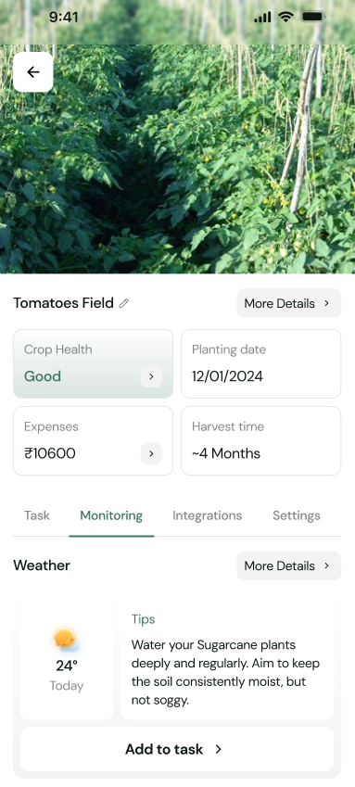
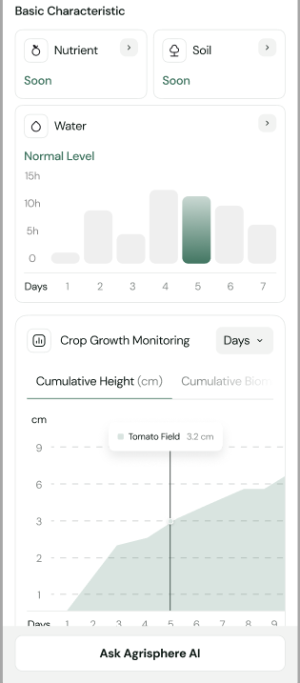
THE SOLUTION
Comprehensive Technology: Our solution integrates real-time soil sensors, AI-based crop diagnostics, and personalized alerts into a single platform that meets all essential farming needs.
Localized and Actionable Insights: Our AI is specifically trained on data for Indian crops and conditions, allowing it to accurately diagnose crop issues and provide instant recommendations tailored to each farmer's unique environment.
Real-Time Alerts for Immediate Action: Farmers receive timely notifications for irrigation, fertilization, and pest control, enabling proactive decisions that reduce crop loss and increase yield.
Why It’s Unique: As a fully integrated and localized solution, it combines hardware, software, and region-specific insights, offering an all-in-one approach that’s difficult to replicate and invaluable to Indian agriculture.

Slide 7
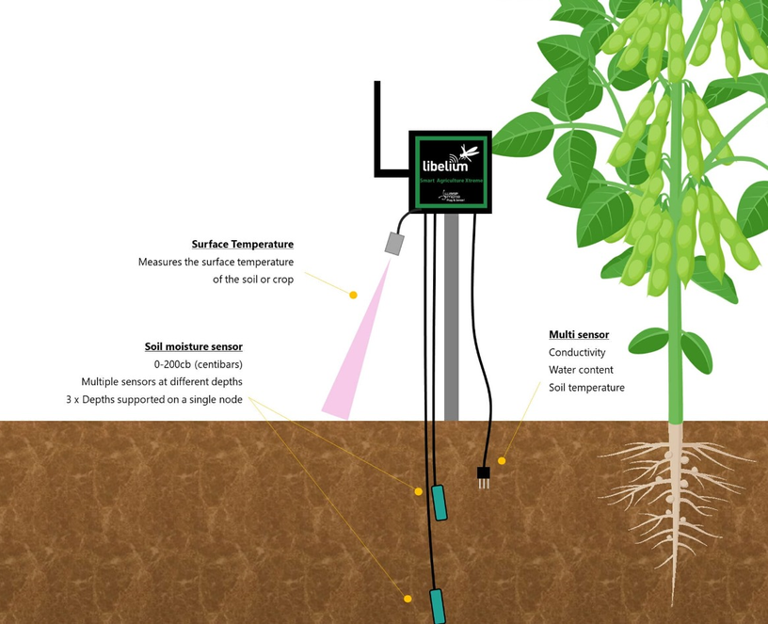
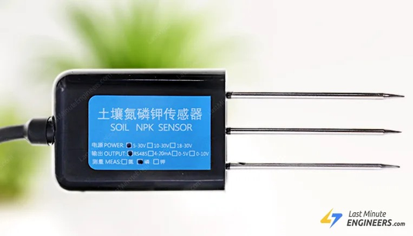
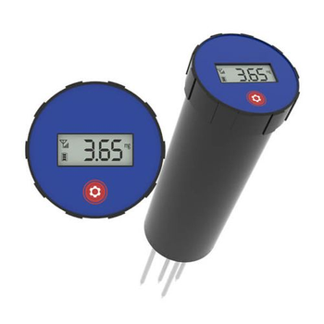
THE SOLUTION
Aspect | Before | After
Intent | Farmers rely on traditional methods, often using guesswork for irrigation, fertilization, and pest control. | Farmers can make data-driven decisions based on real-time insights from our integrated platfor
Action | Actions are typically reactive, addressing issues after visible damage (e.g., wilting, nutrient deficiency). | Actions become proactive and timely, with alerts and recommendations sent directly to farmers’ devices.
Plan | Planning for crop health management is largely based on seasonal patterns and intuition. | Planning is tailored and specific, guided by real-time sensor data and AI diagnostics for each crop stage.

Slide 8
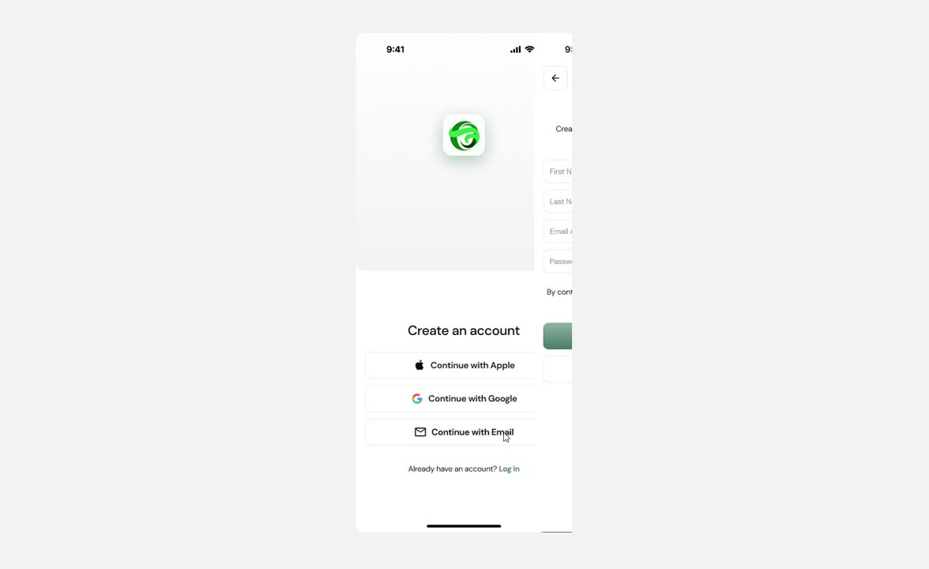

THE SOLUTION

Slide 9

VALUE PROPOSITION
Agrisphere is a "smart farming assistant" that helps "farmers and agri-businesses" achieve "higher yields" and "sustainable profits" through "data-driven, real-time, scientific insights."

Slide 10

COMPETITIONS
Our unique advantage lies in providing real-time soil testing with a physical kit and delivering personalized farming recommendations through a mobile app. Unlike competitors like Fasal, Cropin, and the agri-government sector, which offer general advice or periodic soil tests, our solution offers customized insights for each farm based on accurate, real-time soil data. This makes our solution more precise, accessible, and adaptable to all farm sizes, ensuring better decision-making and higher yields for farmers.
 | Cropin | AgroStar | Fasal | KrishiHub | Agri-gov sector | Agrisphere
Real-Time Soil Analysis with Physical Testing Kit |  |  |  |  | Limited
Customized crop and fertilizer recommendation |  |  |  |  | Limited
End-to-End Farm Management Guidance |  |  |  |  | Limited
Adaptable for Different Farm Sizes
User-Friendly Mobile Application |  |  |  |  | Limited

Slide 11

GO TO MARKET
Customer Support:
AI-driven guidance
On-site kit setup
Warranty
Community Outreach:
Referrals & word-of-mouth
Farmer groups
Agri-cooperative partnerships
Digital Channels:
Social media
Influencer collaborations
Google search ads
On-Ground Marketing:
Demos at local fairs or agri-events
Posters & banners in target areas
Education Empowerment:
Smart farming webinars
Local language tutorials for app & kit setup
Distribution Channels:
Cooperative Partnerships
Online sales platform
Direct sales at events
Key Partnerships:
Agri-cooperatives & government agencies
Farming related financing institutes
Local seed & fertilizer suppliers

Slide 12
REVENUE STREAMS
Revenue Stream | Details | Contribution to Total Revenue
Sensor Kit Sales | One-time sales from sensor kits for soil analysis, installed on customer farms. | 40%
Subscription Fees | Annual or monthly app subscription for real-time, personalized farming insights and premium features. | 25%
In-App Purchases | Premium add-ons within the app, such as advanced pest control, crop yield tools, and premium AI-based insights. | 20%
Partnership Deals | Bulk sales to cooperatives, NGOs, or government bodies for distribution to regional farmers. | 10%
Consulting & Training Services | Customized consulting and training packages for larger farm operations and cooperatives. | 5%

Slide 13
GANTT CHART
YEAR 1
YEAR2
YEAR 3
YEAR 4
PROCESS
Q1
Q2
Q3
Q4
Q1
Q2
Q3
Q4
Research & Planning
Market Research
Data Collection
App Prototype
Sensor Prototype
Testing & Optimization
Field Testing
Optimize Design
Refine based on feedback
Introduce new features
Product Launch
Beta Release
Early Marketing
Official Release
Market Expansion
Scale Manufacturing
Expand Partnership
Expand to additional regions
Build customer support team
National & Product Scaling
Explore export options
Strengthen brand presence

Slide 14
FINANCIAL PROJECTIONS
Market | 2025 | 2026 | 2027 | 2028 | 2029
Units | 7250 | 8520 | 9550 | 10,700 | 11,200
Price per unit (Rs) | 600 | 650 | 725 | 800 | 900
Total Revenue | 43.5 lakh | 55.3 lakh | 70 lakh | 85 lakh | 1 crore
Material & Manufacturing cost | 14 lakh | 16 lakh | 19 lakh | 21 lakh | 24 lakh
Sales and Marketing cost | 1 lakh | 2 lakh | 4 lakh | 6 lakh | 9 lakh
Profit before tax | 28.5 lakh | 37.3 lakh | 47 lakh | 58 lakh | 67 lakh

Slide 15
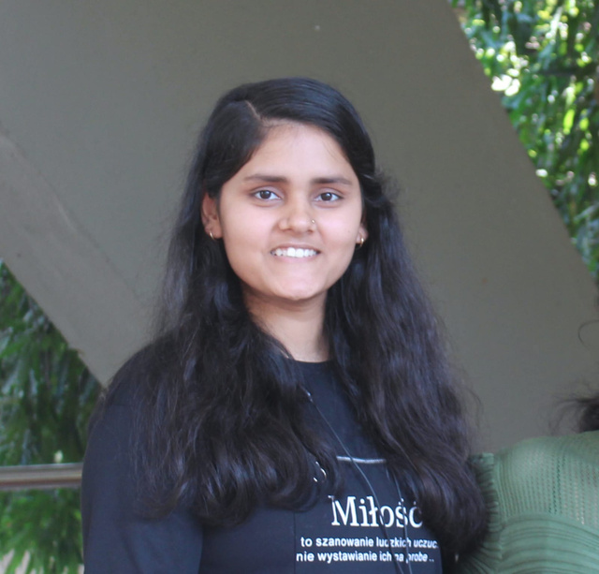
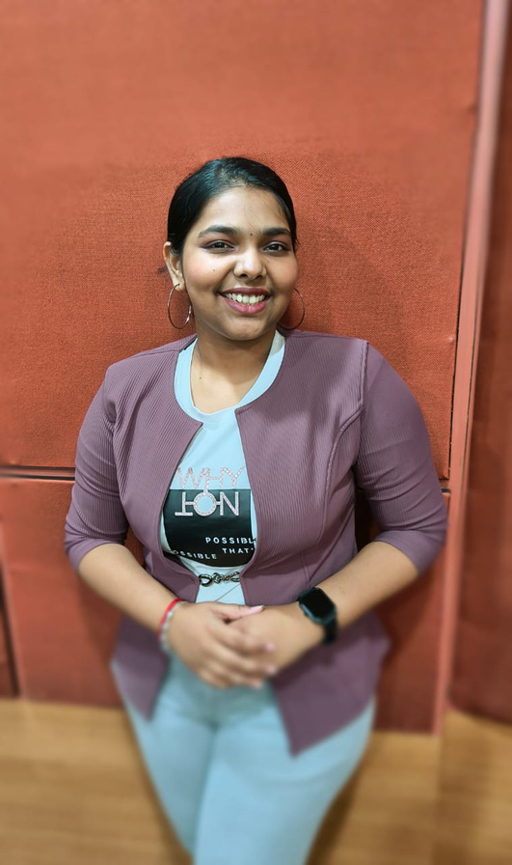

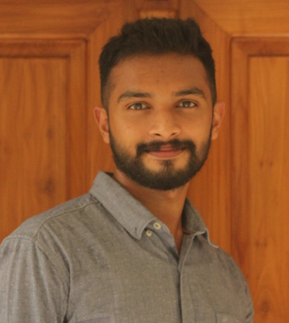


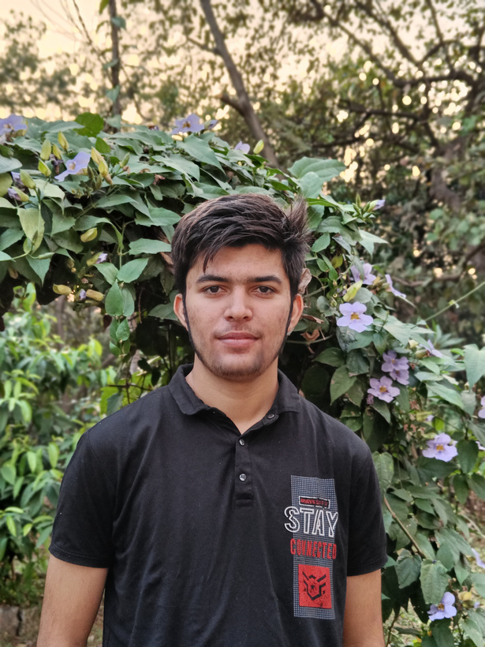

THE TEAM
Anshika Tripathi
Monica S
Anand Shinde
Saurabh K G
Jay Rathod
Mridul Choudhary
Soyal Khan
Himanshi Meena

